Slide 1

Spliceosome Deep learning
Dr: Ibrahim El-Semman

Slide 2
Summary about project
Revealing how spliceosome work with deep learning.
Spliceosome is a large module that is extract intron from mRNA
transcription.
Here, we have designed a deep learning model to reveal how
spliceosome work. Additionally, we have tried to apply an
explainable AI approaches to find the biological meaning from
the trained model using tensorflow, python, published dataset.

Slide 3
What is Spliceosome?
The spliceosome is a large RNA-protein complex that catalyses the removal of introns from nuclear pre-mRNA.
processing done by spliceosome in which the pre-mRNA is transformed into a mature mRNA by Identification and removal of introns (non-coding) regions and then binding of exons (coding) to each other.

Slide 4
Spliceosome Deep Learning
A system for utilizing an artificial neural network to predict splice sites in genes has been studied.
As convolutional neural network (CNN) approaches matured for image processing and computer vision, researchers leveraged biological sequence proximity similarly.

Slide 5
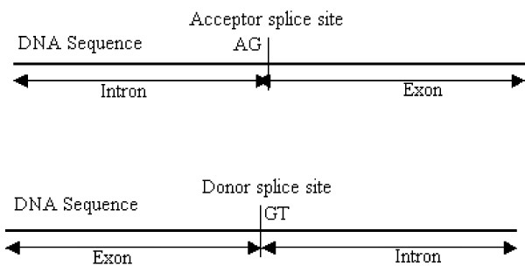
There are two types of splicing :
Acceptor : splicing between introns and exons
Donor : splicing between exons and introns
and Neither : not splicing

Slide 6
About our data
We download from
The file is contain the dataset splicing sites:
https://raw.githubusercontent.com/Illumina/SpliceAI/master/spliceai/annotations/grch38.txt
And link contain the Genome:
http://ftp.ensembl.org/pub/release-105/fasta/homo_sapiens/dna/

Slide 7
Coding

Slide 8
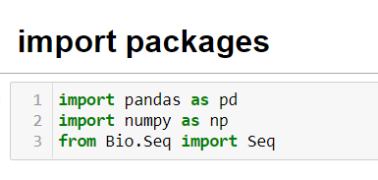
We use this packages as :
pandas: to read the text file as csv
numpy: to make array and matrix
Bio.Seq: to enable us to make reverse complement to sequence

Slide 9
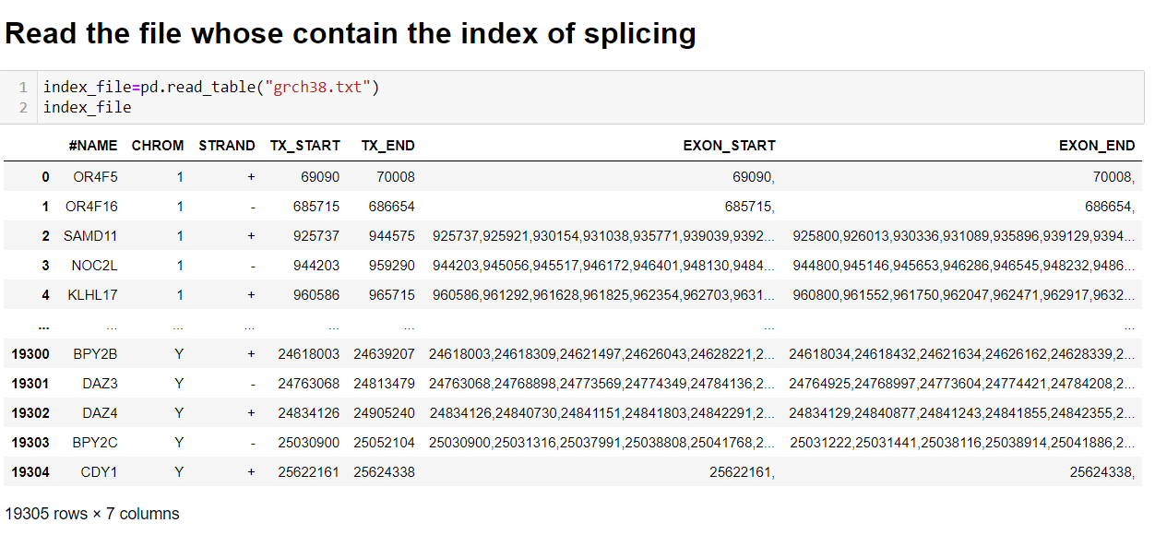
When read the file the table shown has columns as :
#NAME: is contain the name of gene.
CHROM: contain the number of chromosome.
STRAND: +(splicing the left hand) is original , -(splicing the right hand) is reverse complement.
TX_START: the index of the start transcription.
TX_END: the index of the end transcription.
EXON_START: the index of the start exon.
EXON_END: the index of the end exon.

Slide 10
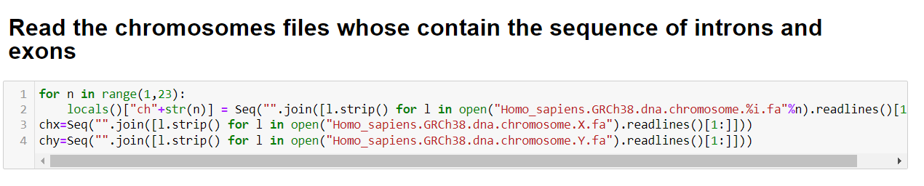
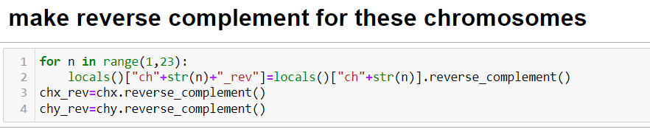

Slide 11
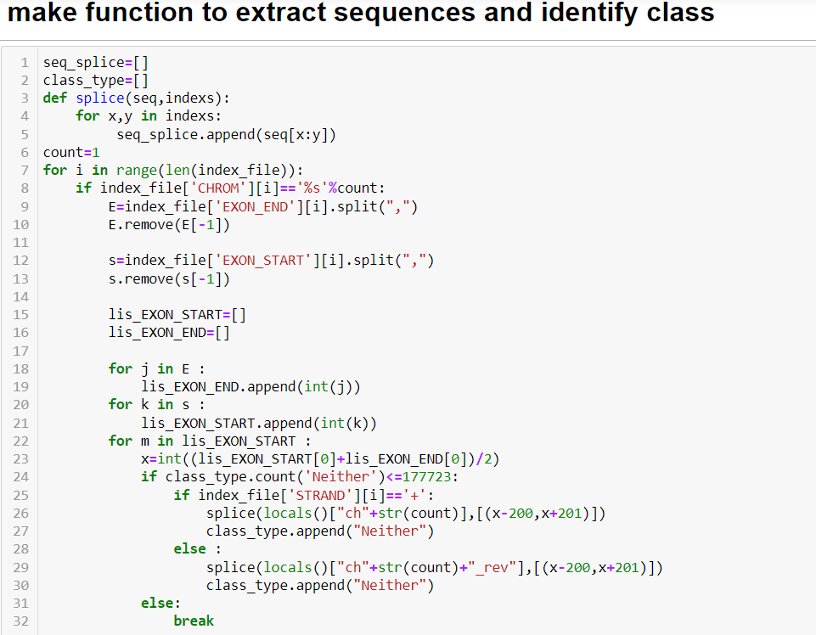

Slide 12
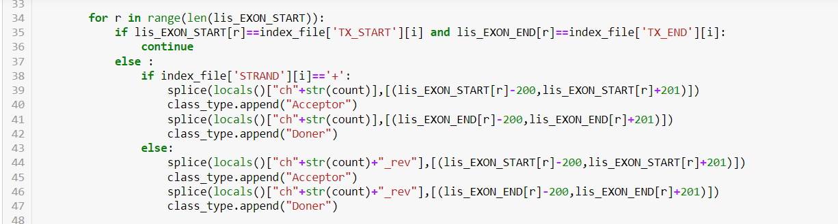

Slide 13
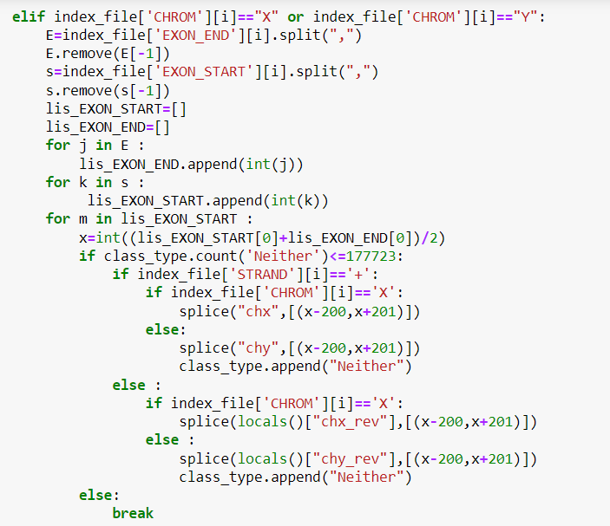

Slide 14
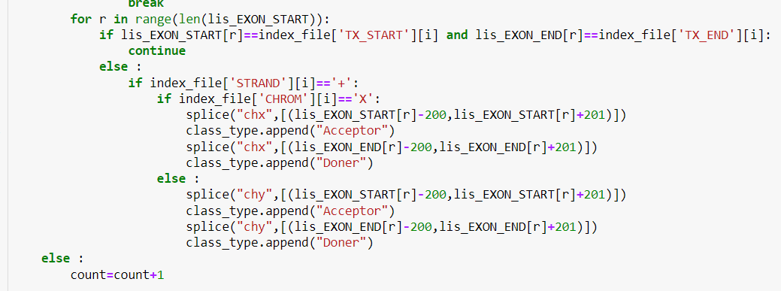

Slide 15
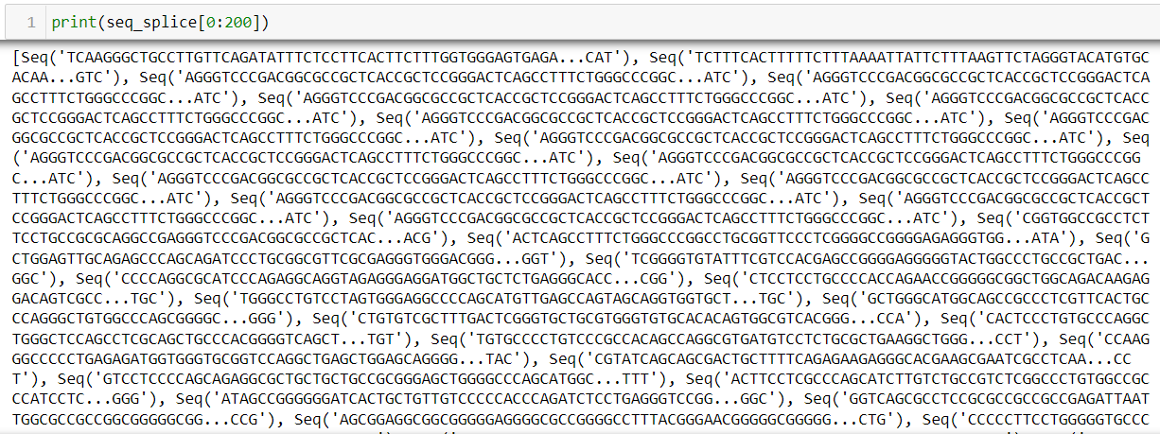

Slide 16
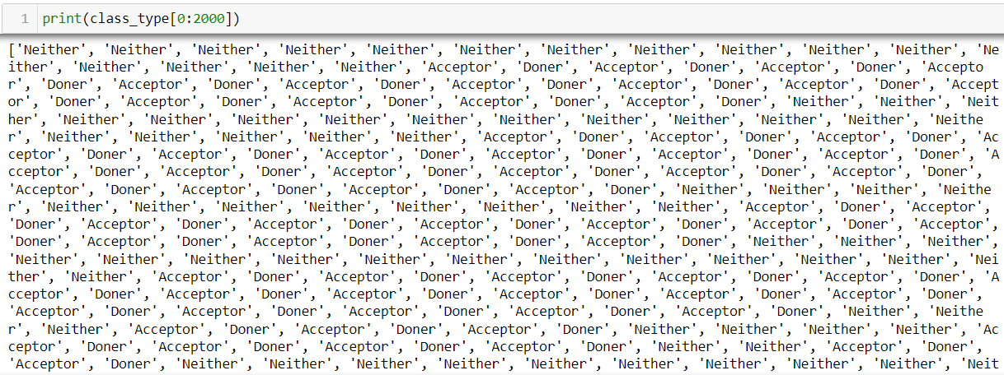

Slide 17
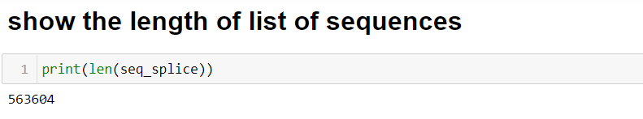
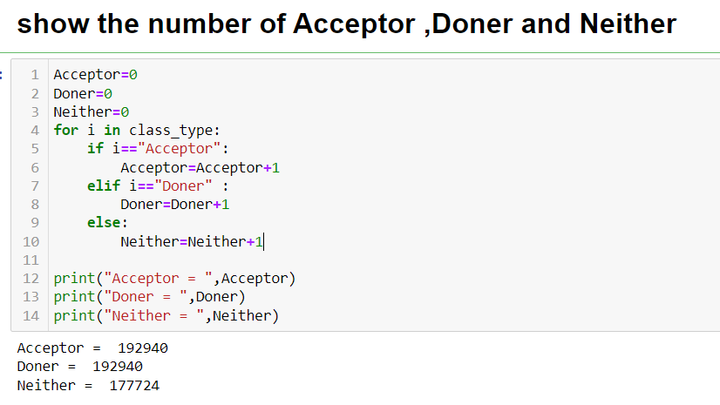

Slide 18
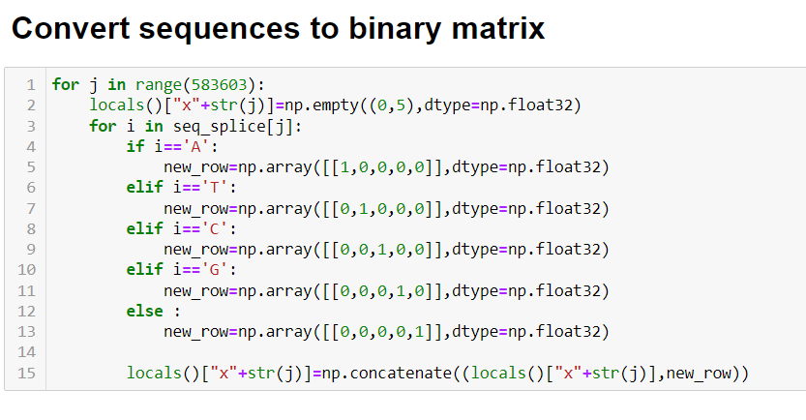

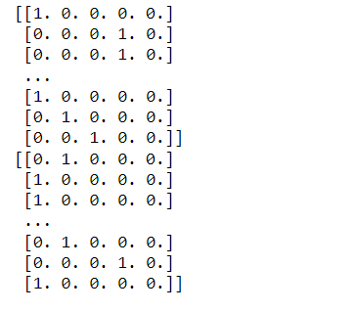

Slide 19

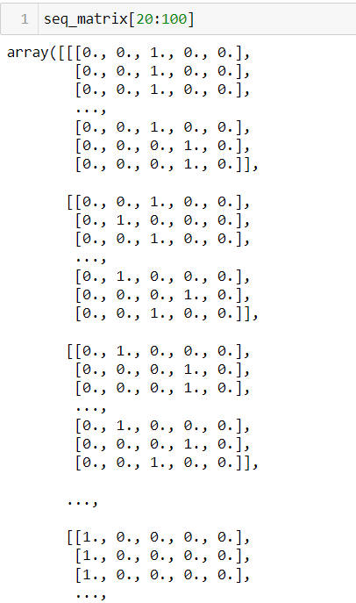
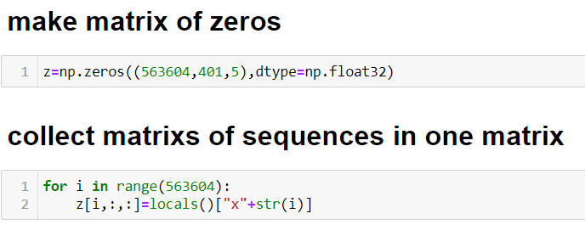

Slide 20
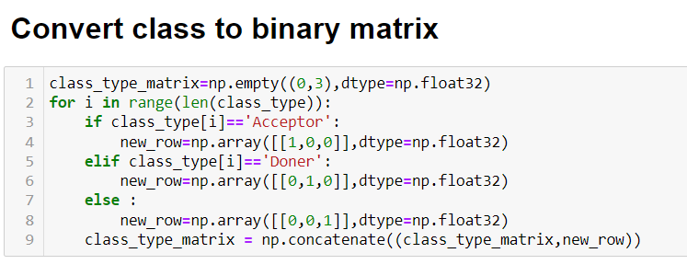
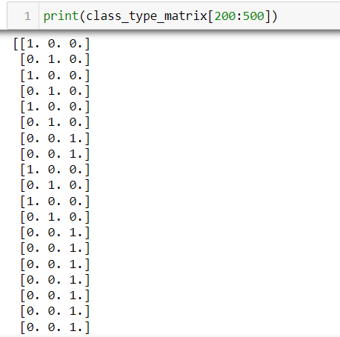

Slide 21
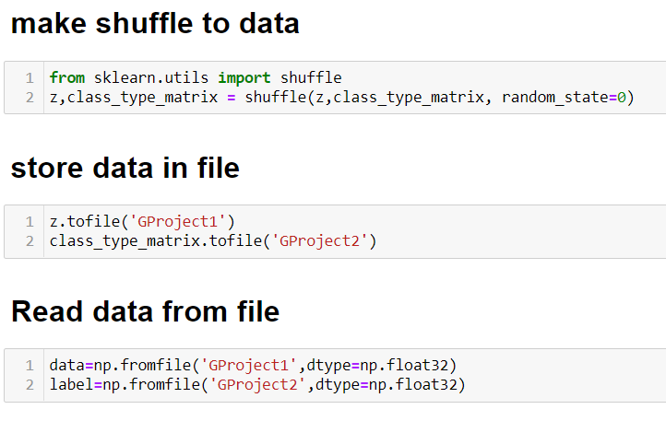
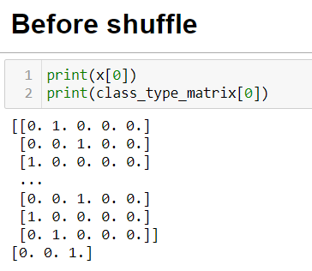
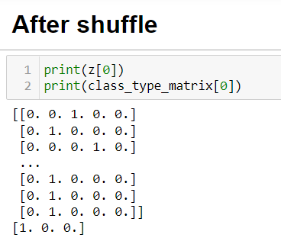

Slide 22
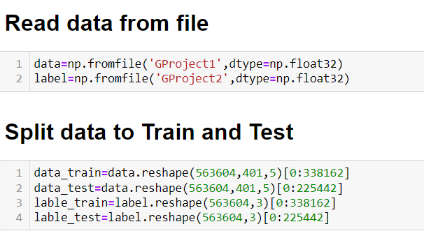
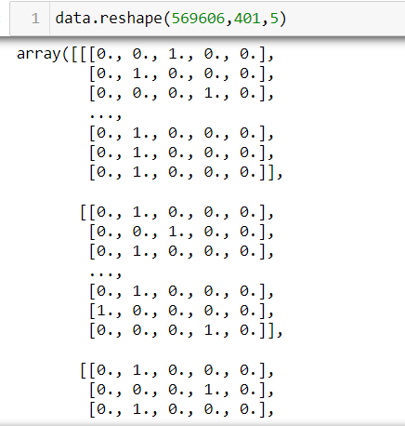
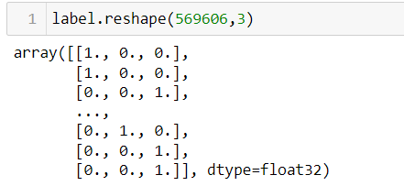

Slide 23
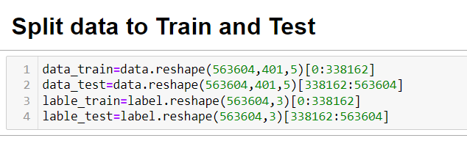

Slide 24


Slide 25
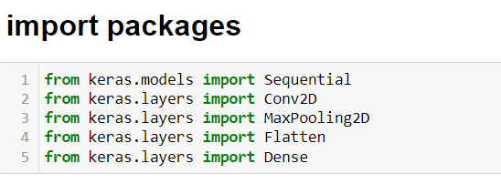
We use this packages as :
Sequential: provides training and inference features
Conv2D: use several filters to know very specific features
MaxPooling2D: a convolution process where the Kernel extracts the maximum value of the area it convolves.
Flatten: converts the values of the Max pooling matrix into a one-dimensional array
Dense: hidden layer

Slide 26
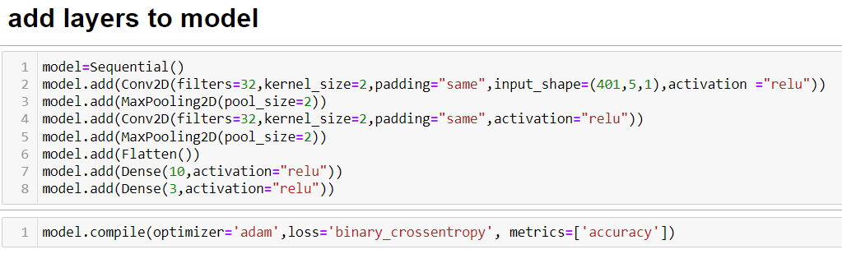

Slide 27
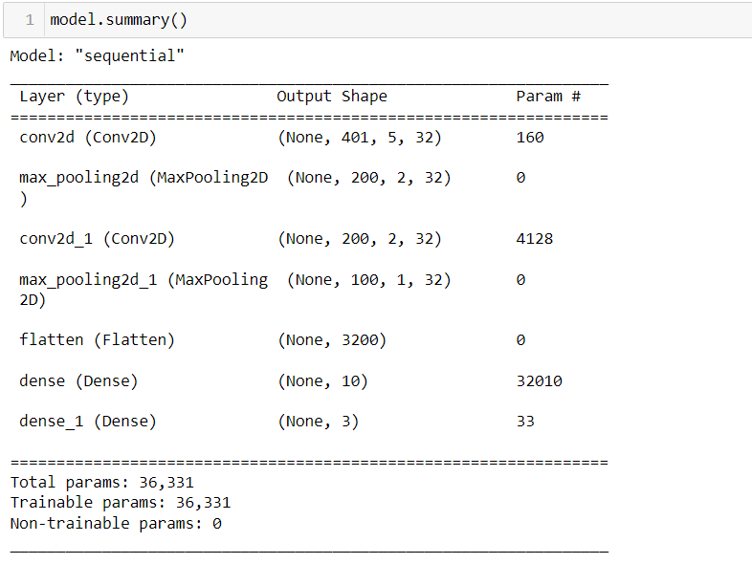

Slide 28
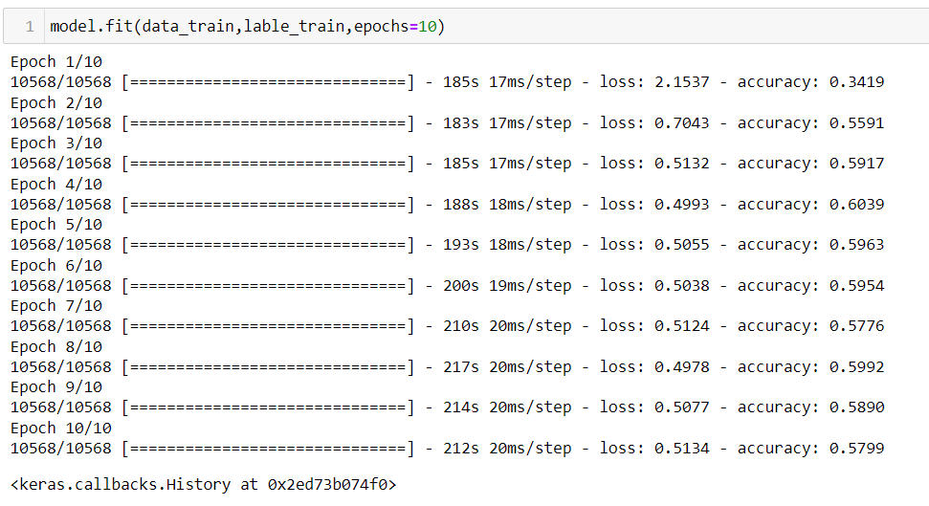

Slide 29
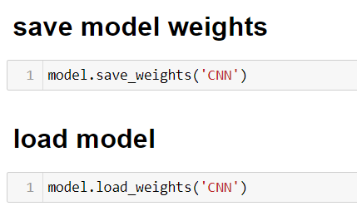

Slide 30
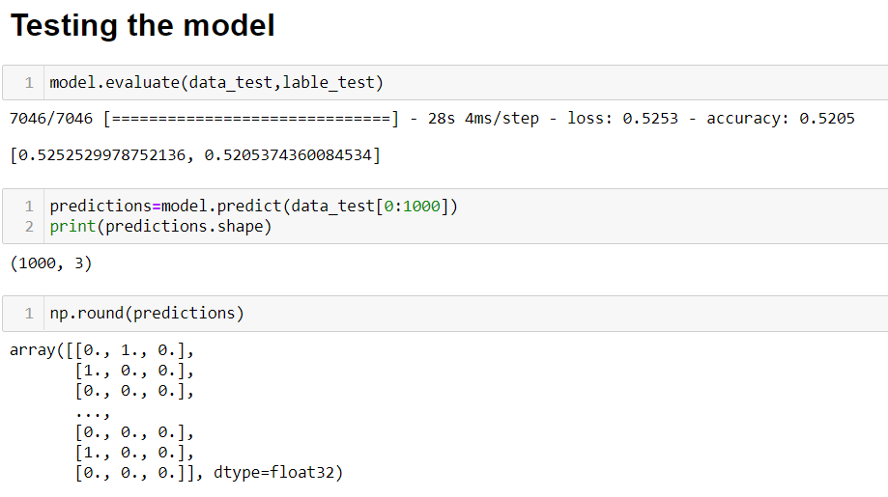

Slide 31


Slide 32
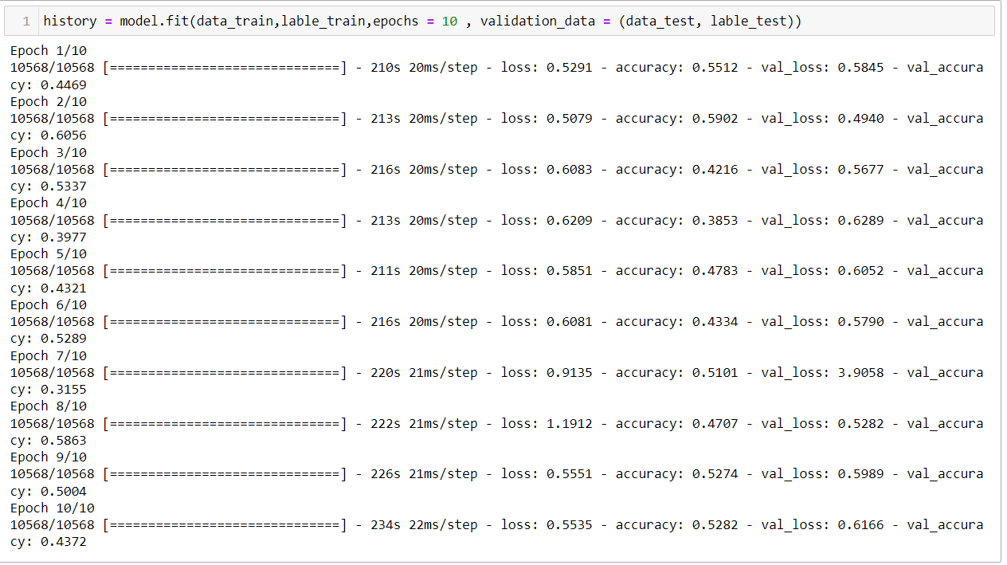

Slide 33
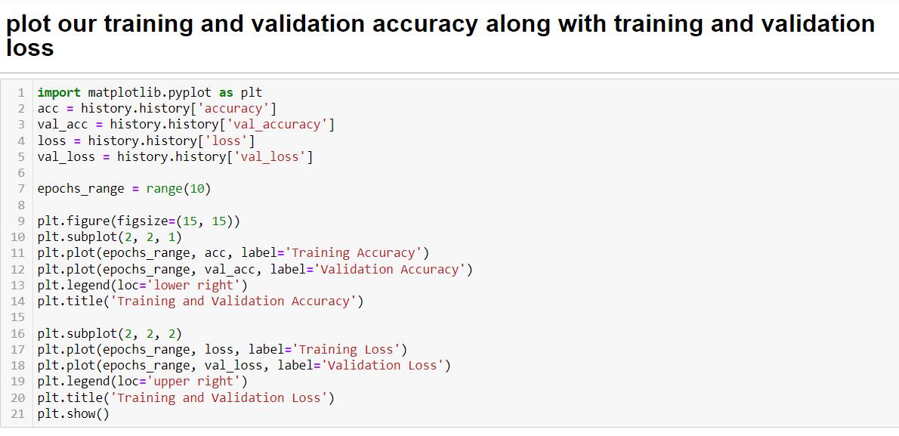

Slide 34
